Slide 1

Executive Summary: Drive Fruit Co. growth through store expansion, supply chain optimization, product diversification, and improved purchasing experience (Aptos Narrow, Bold, 20pt)
Fast-paced implementation is supported by strong existing operational capacity in chosen markets
Optimizing Returns
Restructure merchant projects to stabilize cash flows while expanding EE’s global BESS network in high-return markets. Convert German standalone tolling projects to drive equity growth. Portfolio equity allocations optimized via Mixed-Integer Linear Programming. (Aptos, Regular, 14pt)
1
Key Priorities
Year | Mkt Size | Fut Mkt Size | Item 4
2020 | $61Bn
2030 | $115Bn
Long-Term Value Creation
Bridge the value gap between high-output and low-revenue markets via full-chain control
Capital Recycling
Anchor BESS growth in high-capability markets for reliable expansion
Lithuania – €37.1Mn Y1
Adopt short development cycles to keep pace with rapidly evolving battery tech
Slash costs with 30% CAPEX grants
Key Priorities (Aptos, Bold, 16pt)
Existing customers show relatively lower price sensitivity
3
Long-Term Value Creation
Bridge the value gap between high-output and low-revenue markets via full-chain control
Capital Recycling
Anchor BESS growth in high-capability markets for reliable expansion
Recommend raising ex-factory prices by CN¥0.25–0.30 per bottle for Genki Forest
Retail prices could rise CN¥0.30–0.50 per bottle
Implementation risks and mitigations identified
Source: expert interviews, literature review, analysis (Aptos, Regular, 12pt)
1

Slide 2
Summary: Yada’s development strategy in China incorporates multi-level senior care patterns and more customized services
Fast-paced implementation is supported by strong existing operational capacity in chosen markets
Market
Strategy Design
Analysis
Dimensions
Policy Sorting
Market Overview
Customer Analysis
Industry Chain
Competitive Analysis
Pain Points
Customer Segmentation
Shanghai, the Pilot Region
Private Service at Home
Intelligent Community
Mid-class Living at Home
Normal Community Service
Business Expansion
Financial Products
Investment
Law Consultation
End-of-life Care
Implications
Yada should capture market trends and meet the increasing demand for elderly care services, as a reputable company.
Yada pension actively fulfills its social responsibility and pays attention to social welfare and elderly’s health security. Yada should implement strategies to reach a broader population and meet diverse needs.
Achieve healthy revenue growth in Mainland China senior living & care market
Source: expert interviews, literature review, analysis (Aptos, Regular, 12pt)
2

Slide 3
Building Long- Term Value in Australia: Co-developing BESS with ongoing Australian solar projects prevents a recurrence of volatility driven weak returns
23% | record high negative price dispatch interval
10GW+ | project pipeline active in Australia
$13.6Bn | record quarterly investment in BESS
Improve Viability in New and Expanding Geography
Leverage Trading Inefficiencies
Future Proofing
Australia’s NEM exhibits higher trading volatility and structural inefficiencies
Capture arbitrate revenue during surges
Utilize machine learning to optimize PPAs and dispatch strategies
Leverage existing and under-construction and existing projects as anchor sites
Accelerate time to market as a flexibility trade with merchant offtake agreement
Co-deploy BESS with ongoing projects to prevent future generation revenue gaps.
Capture potential inefficiency gains whilst hedging downside
Establish an efficient, low-risk foothold in a volatile but high-potential market
Build resilience against curtailment and long-term revenue compression
Turn Australia’s market volatility into a data-driven competitive edge
Source: expert interviews, literature review, analysis (Aptos, Regular, 12pt)
3

Slide 4
Risk Mitigation: The blended ownership model offsets the proposal's most critical risks, protecting against severe downside
Fast-paced implementation is supported by strong existing operational capacity in chosen markets
High
1
Germany Regulatory
Environment
Slow project approval and project sales could
significantly slow ability to cash recycle
2
High Leverage Risk from Merchant Agreements
If price volatility stabilizes, long-term ROI could sharply decline without floor price guarantee
3
6
3
Rapid BESS Technology Advancements
Rapid BESS advancement and adoption could
leave existing projects inefficient, reducing ROI
2
4
Operation & Construction Delays
Delays could tie up capital and prevent EE's ability to secure a dominant market position
Impact
1
4
5
Lack of Project Sale Buyers
Slow project sales could slow cash recycling, but EE would generate returns in intermediary
5
6
Fail to Secure Sufficient Debt Financing
Projections depend on sufficient debt
financers, influenced by macro trends
The proposed two-phase approach involves both long-term merchant retrofit ownership and short-term project sales. This means that the risks of each phase (1) and (3) offset each other because they have different ownership timeframes.
Low
Probability
High
Source: expert interviews, literature review, analysis (Aptos, Regular, 12pt)
4

Slide 5
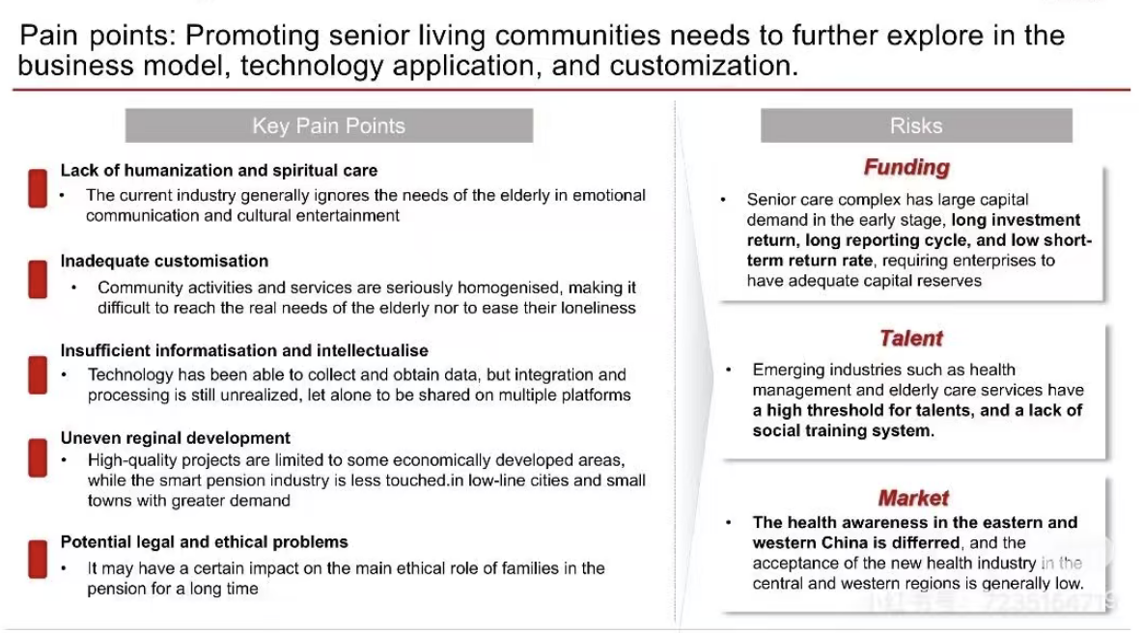

Slide 6
Implementation Timeline
Fast-paced implementation is supported by strong existing operational capacity in chosen markets
2026H1
2026H2
2027H1
2027H2
2028H1
2028H2
Key Considerations
Retrofitting to Stabilize Cashflow and Expand Control
Complete Lithuania work
Profit Stabilizing
1
Reinvest profits into offsetting OPEX cost Monitor BESS and invest in new technologies
2
Completion of Denmark work Secure grid upgrades and
All of Lithuania's retrofitted power was acquired due to its high profitability ratio strategic first-mover advantage, and profit stabilizing the poor performance of existing farms
Remaining funds were invested in Denmark to improve profit margins (20% of energy generated contributed only 4% of revenue), strengthening domestic profitability. Rapid operational improvements could position the business well for a future IPO
Strategize market entry
Monitor potential option to enter standalone
4
Expansion into the new geographic market - Australia
3
Completion of Australia retrofitted Project
Continued investment into project if profitable
5
Capture highly profitable Germany
Strategize market entry and leverage connections to mitigate regulation hurdles
Strengthen relationships with potential investors and investment banks
6
Completion of standalone German BESS Continue expansion if project profitable with strong demand
Expansion Plan
Key Pricing Spending
Expansion into Australia followed, driven by the high profitability of retrofitted projects and strong macro tailwinds
Remaining capital was invested in Germany's standalone and tolling operations to enhance portfolio diversification, with attractive M&A valuations supporting potential high-margin SPV sales
Year 1
Year 2
Year 3
1
€37.1 million invested
3
€50 million invested
5
€16 million invested
2
€62.9 million invested
4
€50 million invested
6
€50 million invested
7
€14 million buffer capital
Overview
Analysis
Strategy
Implementation
Impact
6

